Slide 1

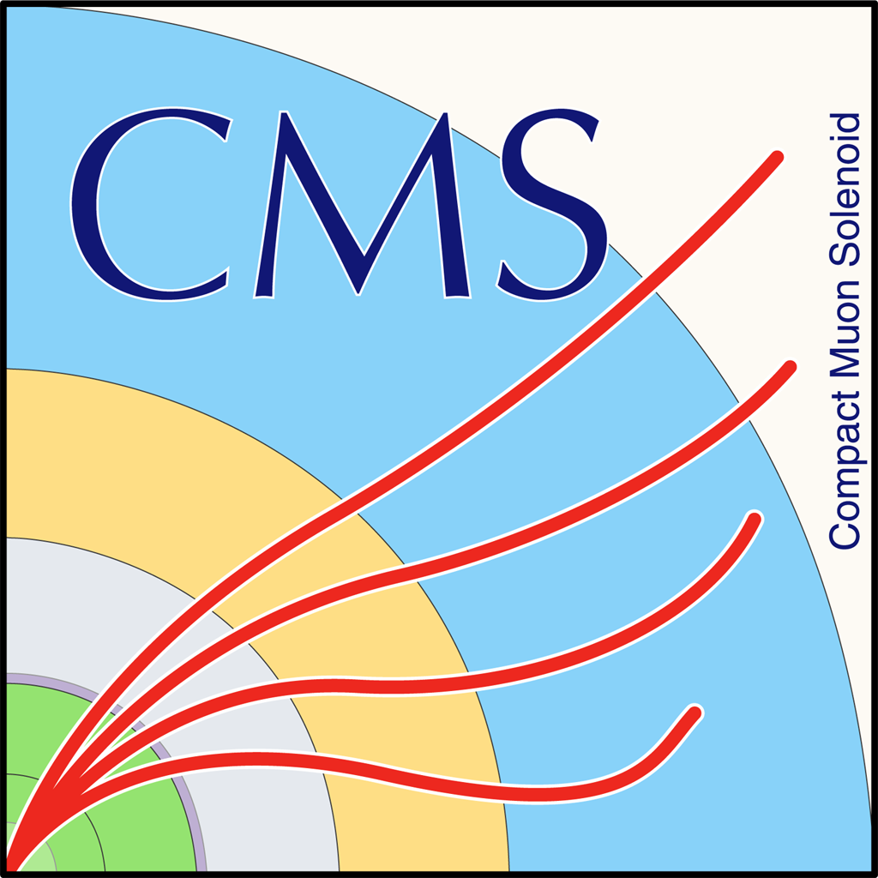
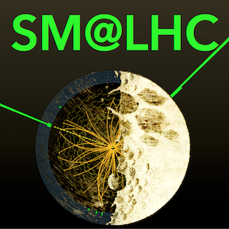
Spin, Anomalous Couplings, CP structure
Rebeca Gonzalez Suarez
University of Nebraska, Lincoln
Standard Model at LHC, 21-24 Apr 2015,
Galileo Galilei Institute, Florence (Italy)

Slide 2
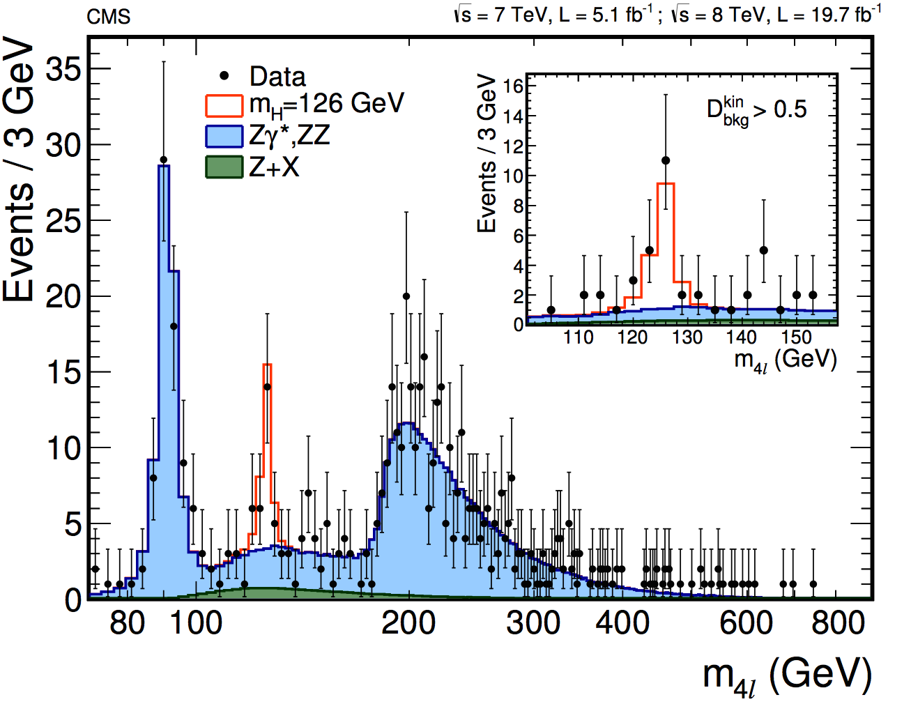
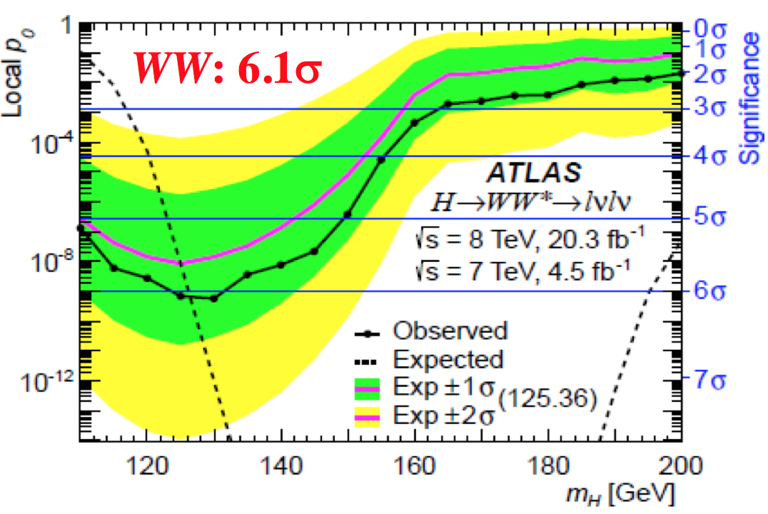
Introduction
In 2012 we discovered the Higgs boson
But is it really “The” Higgs boson?
It is a neutral particle with a known mass that decays as the SM Higgs would
Study fundamental properties
→ Spin, anomalous couplings and CP structure
ATLAS and CMS have extended studies of the spin-parity properties of the Higgs boson:
full LHC Run-1 dataset, 7 and 8 TeV
H→ZZ, H→WW, H → γγ decay channels
ATLAS-CONF-2015-008
18 March 2015
arXiv:1411.3441
13 Nov 2014
arXiv:1503.03643
12 March 2015

Slide 3
Two kind of analyses
Straightforward: Test of different BSM spin and CP hypotheses
→ Exotic spin-1 or spin-2, BSM 0⁻ 0⁺_{h}
More complicated: study of the tensor structure of the HVV interactions setting limits on anomalous couplings under spin-0 assumption
ATLAS and CMS perform:
Hypothesis testing → Different J^{CP} models are compared with the SM versus the data and ruled out individually
Parameter estimation → where different parameters related to anomalous couplings are measured
Rely on simulation of the alternative hypotheses, done with:
MadGraph5_aMC@NLO, POWHEG+JHUGen (ATLAS)
POWHEG+JHUGen (CMS)

Slide 4
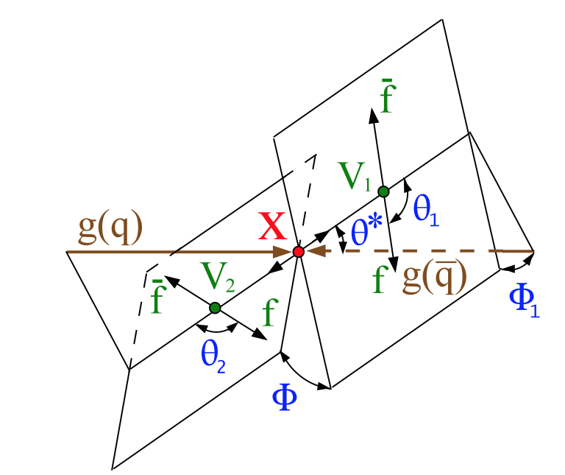
Kinematic variables
The analysis is done via the study of the kinematic distributions of the decay products
Determined by the tensor structure of the HVV interactions
The number of kinematic variables available depends on the Higgs decay → determines the strategy followed in each channel
Production:
gg/qq/any
Decay:
ZZ/Zγ*/γ*γ * → 4l, WW→2l2ν, and γγ
Two production angles:
θ∗ and Φ₁ in the X rest frame
Three decay angles:
θ₁, θ₂, and Φ in the V rest frames

Slide 5
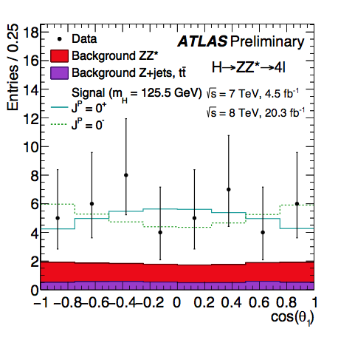
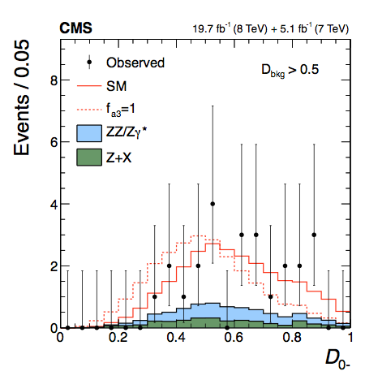
H→ZZ→4l
The complete final state can be reconstructed → Full kinematic information accessible → Best sensitivity
8 kinematic variables: 5 angles : θ*,θ₁,θ₂,Φ,Φ₁ ; 3 masses: m_{Z1}, m_{Z2}, m_{4l}
The information is condensed in a set of discriminants based on:
Matrix Element calculations, such as the Matrix Element Likelihood Approach (MELA) or BDT discriminants trained with simulation

Slide 6
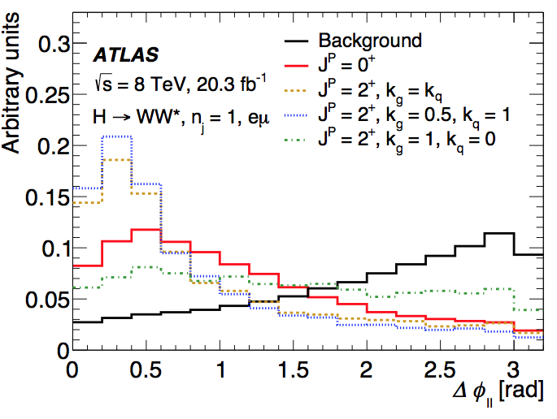
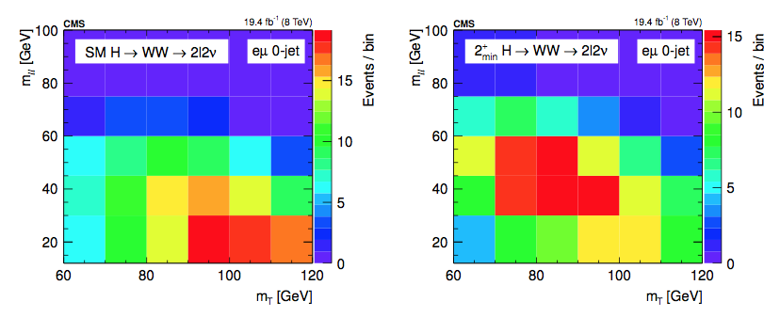
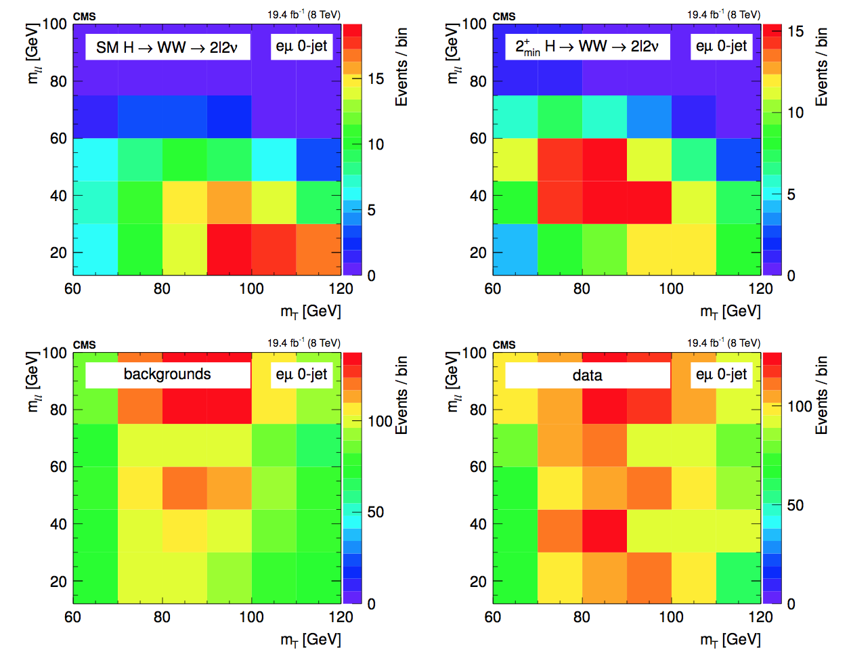
H→WW→2l2ν
Two lepton final state (eµ), two neutrinos
→ full final state cannot be reconstructed
Rely on limited set kinematics
m_{ll,} m_{T} (CMS) - m_{ll} , Δφ_{ll} , p_{T}^{ll}, m_{T} (ATLAS)
The analysis is performed using
2D templates (legacy SM analysis) (CMS)
BDT trained using input variables (different BDTs for SM signal/background, BSM signal/background, SM signal/BSM signal) (ATLAS)

Slide 7
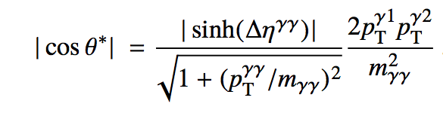
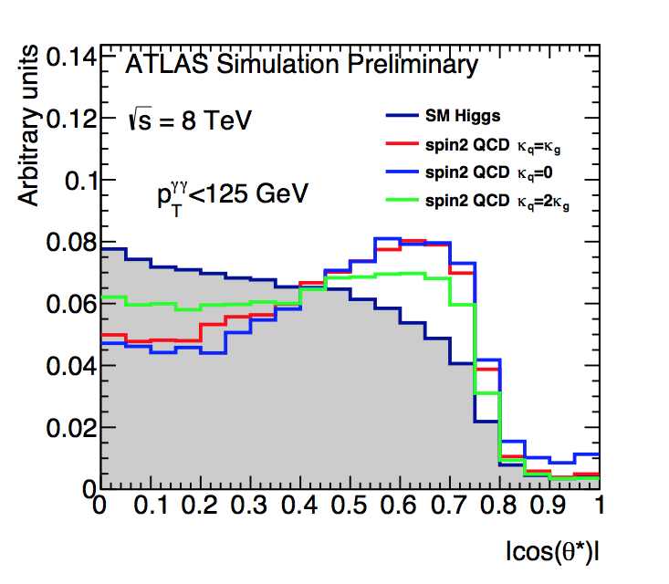
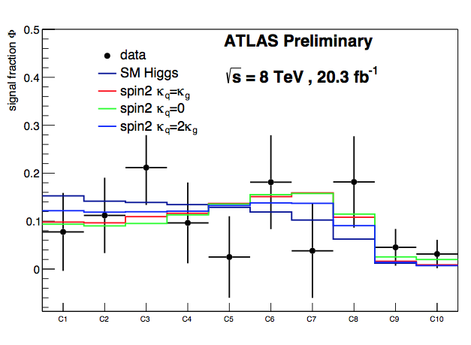
H→γγ
Only a single kinematic variable encodes the spin information
cosθ* : cosine of scattering angle in the Collins-Soper frame
Both ATLAS and CMS use the same variable and follow their respective legacy H→γγ analyses

Slide 8
Spin studies
The main sensitivity comes from H→ZZ→4l channel
H→WW and H→γγ also used and combined
Hypothesis testing of SM against:
All mixtures of spin-1 states
1⁺, 1⁻ and mixed, qq produced
Several individual spin-2 models
Comprehensive set of benchmark states
qq, gg produced
Spin-0
Pure pseudoscalar 0⁻ and pure scalar with higher order corrections 0⁺_{h}
Test statistic used to quantify the consistency of the two models with data

Slide 9
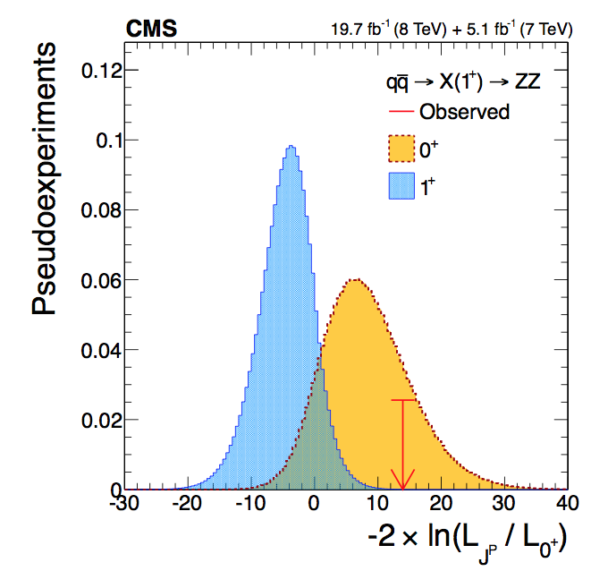
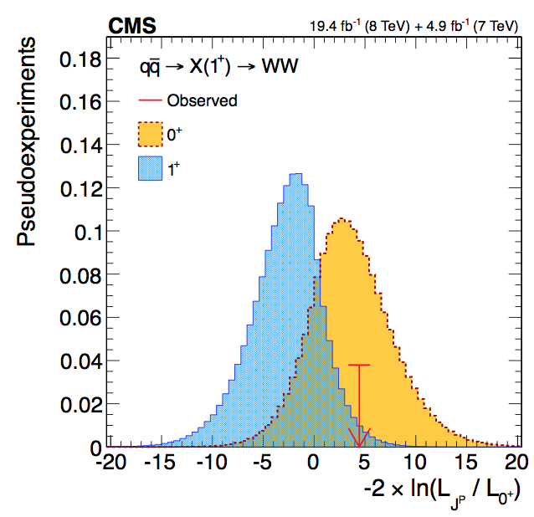
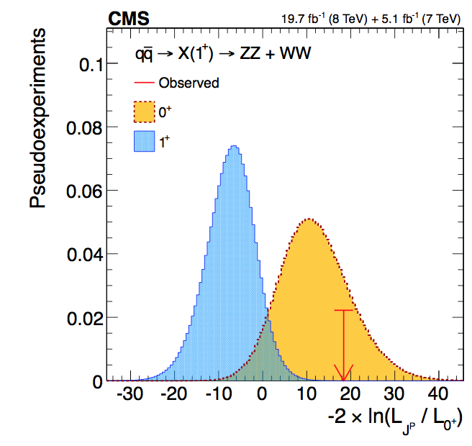
Spin-1
J=1 not allowed for X→𝛾𝛾 by the Landau-Yang theorem
Spin-1 models tested anyway experimentally
under the hypothesis that the excess in WW and ZZ is not the same resonance as 𝛾𝛾
pseudovector 1⁺

Slide 10
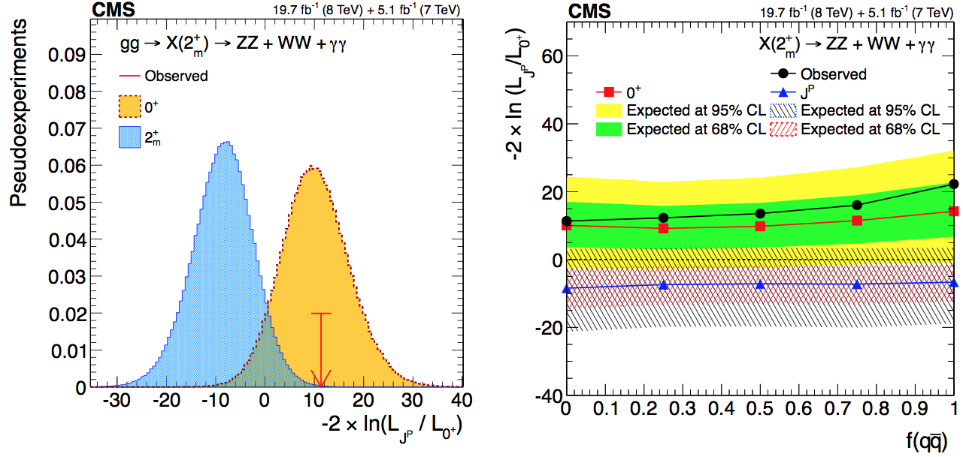
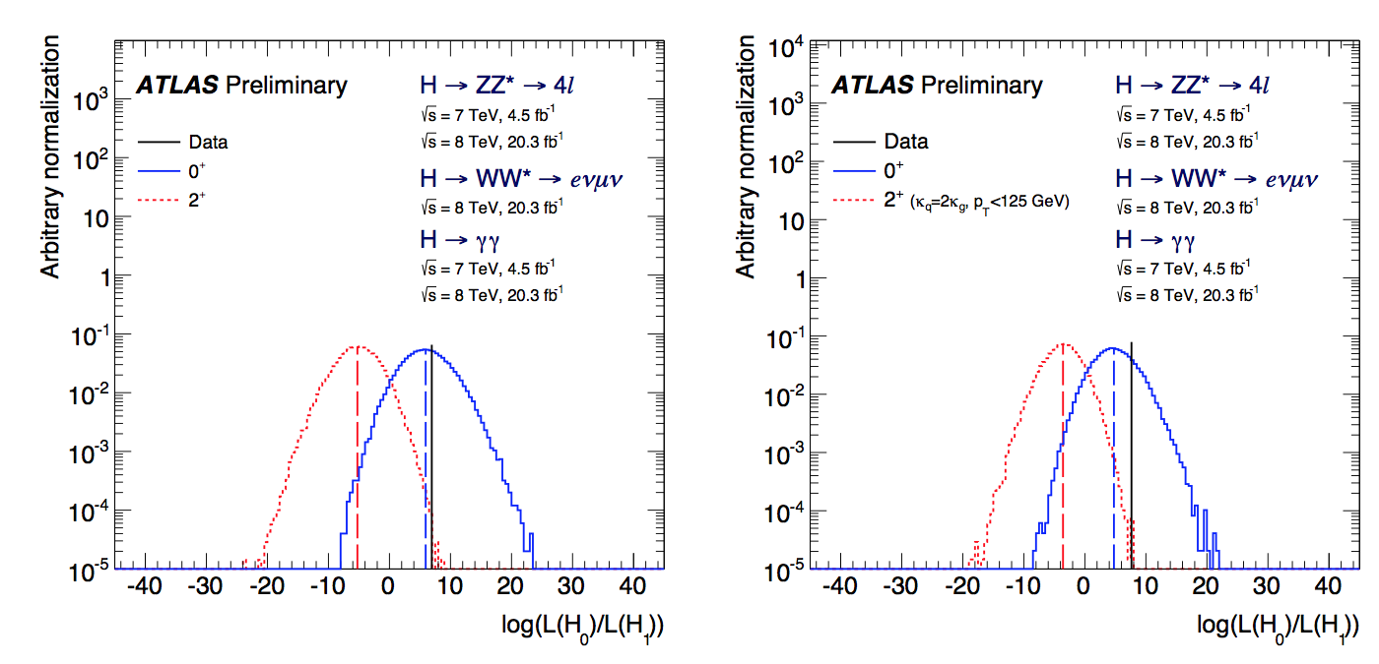
Spin-2
X→ZZ+WW+γγ combination for 2⁺_{m} model: graviton-like with minimal couplings
X→ZZ+WW+γγ combination for 2⁺ model for universal and non-universal couplings

Slide 11
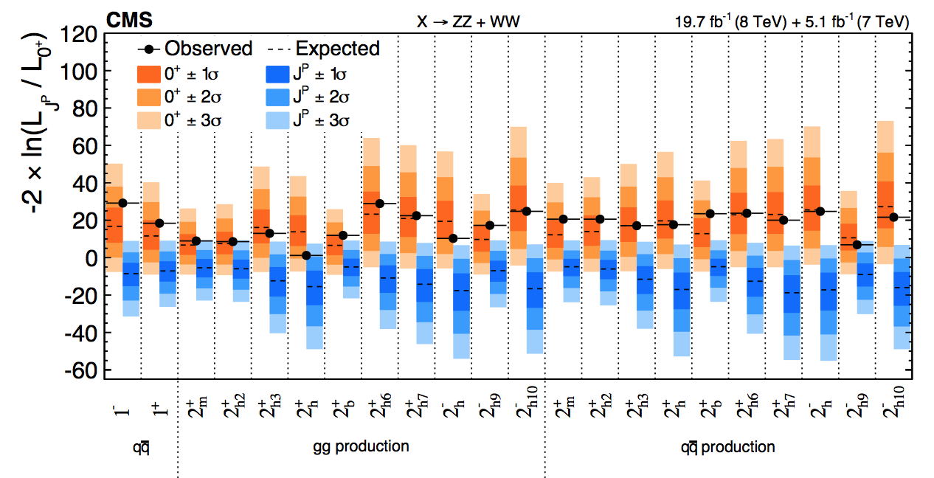
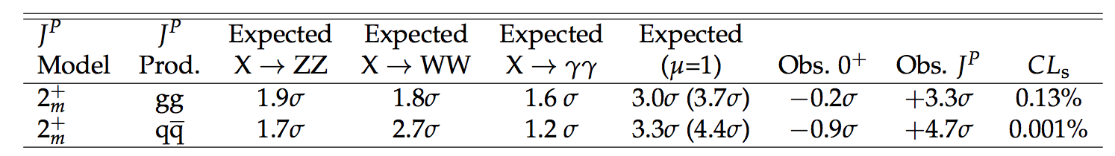
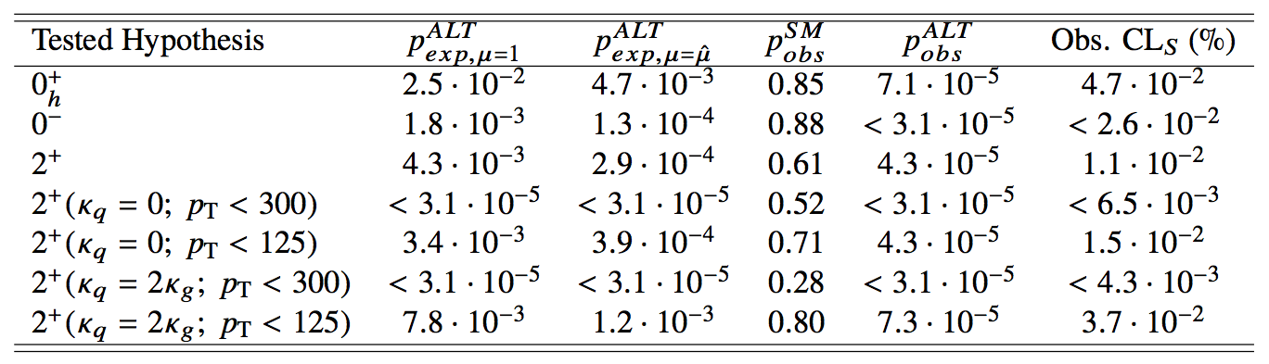
Exotic Spin Results
All spin-1 hypotheses excluded at > 99.999% CL , Spin-2 boson 2⁺_{m}, excluded at a 99.87% CL, other spin-2 hypotheses excluded at a ≥99% CL
All considered non-SM spin hypotheses excluded at > 99% CL in favor of the SM

Slide 12
Anomalous Couplings
Both ATLAS and CMS exclude all the exotic spin 1 and 2 hypotheses tested at 99%CL or higher
The new boson has spin 0
Pure pseudoscalar hypothesis, 0⁻, ruled out
It appears to be compatible with the J^{CP}=0⁺⁺ SM state
It still could be a mixture of CP states → the couplings to gauge bosons could have small anomalous components
We need to study the tensor structure of the HVV interaction
Hypothesis testing is not sufficient → parameter measurement
ATLAS and CMS follow similar routes while measuring slightly different parameters

Slide 13
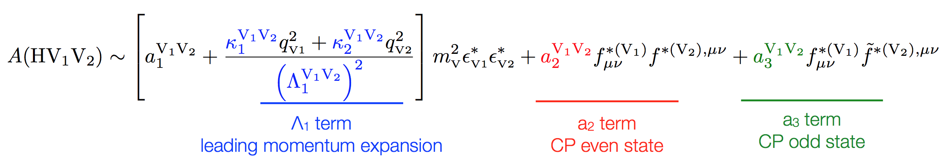
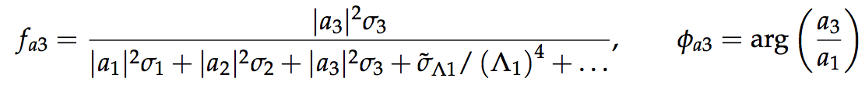
Spin-0: CMS
The decay amplitude for a spin-0 boson to a pair of V bosons can be described as:
We choose a parameterization that relates cross sections fractions (f_{a2}, f_{a3}, f_{Λ1}) to a₂, a₃, and Λ₁
σ_{i} in each case corresponds to a_{i} = 1 and a_{j≠I} = 0
f_{a1} = 1-f_{a2}-f_{a3}-f_{Λ1}-… is the SM contribution → expected to dominate
For a measured value of f_{x} → possible to extract the ratio a_{i}/a₁

Slide 14
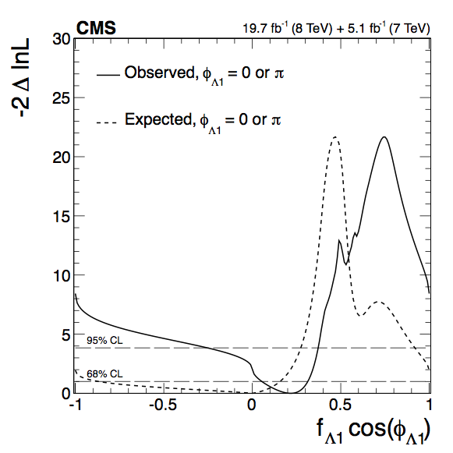
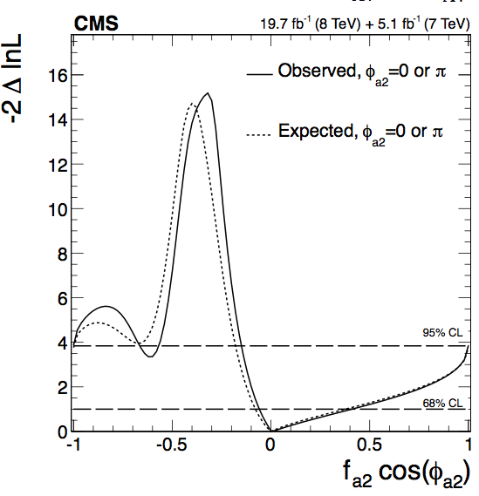
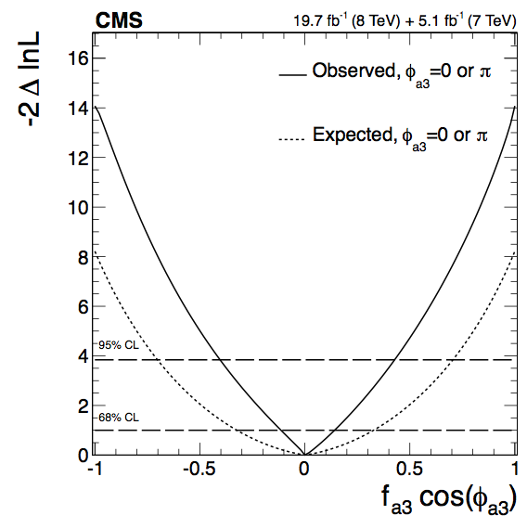

Likelihood scans of f_{x}
Likelihood scans for the three effective fractions for H→ZZ→4l (most sensitive channel) in the most representative scenario
Couplings constrained to be real, other couplings fixed to the SM
Full set of scans available, e.g. allowing complex phases. fitting more than one parameter at a time …
→ all consistent with the SM
cosφ term allows for a signed quantity
cosφ= −1 (π) or +1 (0)

Slide 15
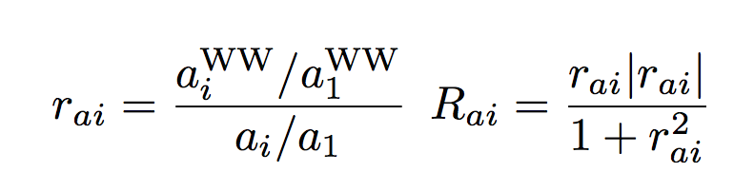
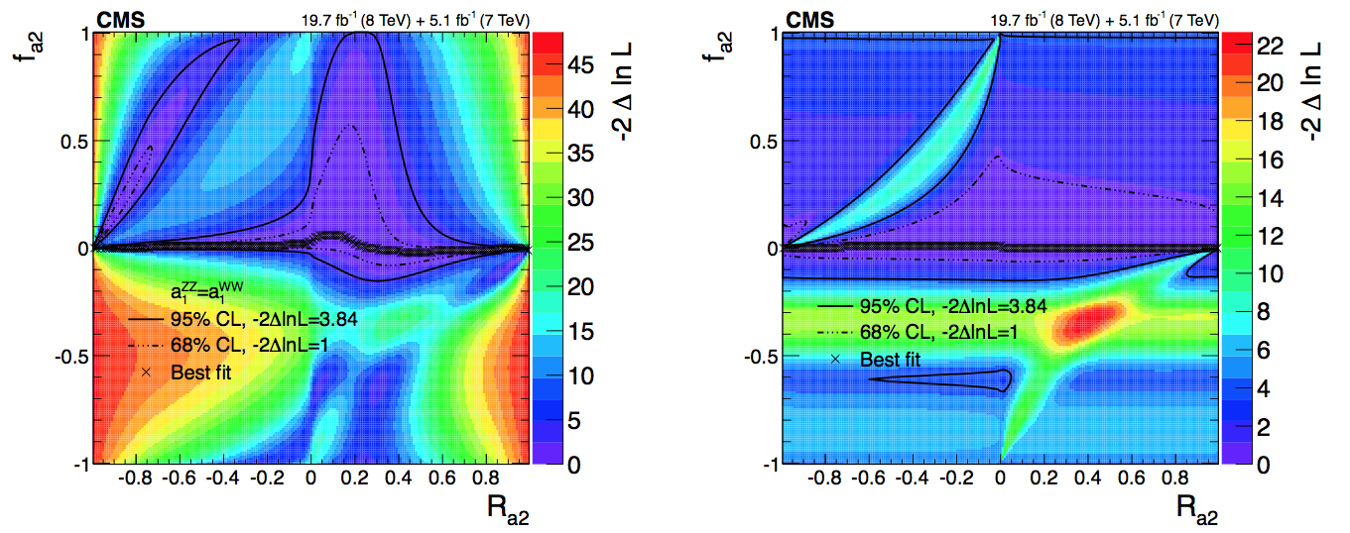
H→ZZ and H→WW combination
General relationship between HWW and HZZ couplings
f_{ai} can then be written as a function of f_{ai}^{WW} via R_{ai}
Two scenarios for combination: arbitrary relationship between a₁ for W and Z or custodial symmetry
r_{ai} [−∞, +∞]
R_{ai} [−1,+1]
a₁^{WW} ≠ a₁^{ZZ}
a₁^{WW} = a₁^{ZZ}

Slide 16
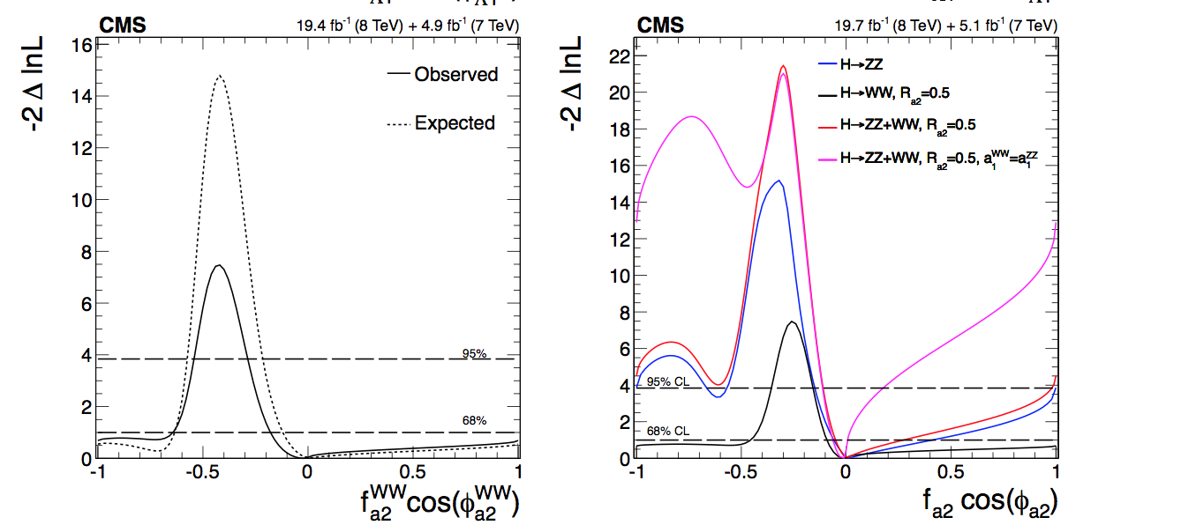
H→WW and H→ZZ combination
We pick R_{a2}=0.5 (r_{a2}=1) for illustration purposes
Not assuming custodial symmetry the combination is close to the sum of the two individual curves
In the custodial symmetry scenario a greater exclusion is achieved because the yields are related
H→WW

Slide 17
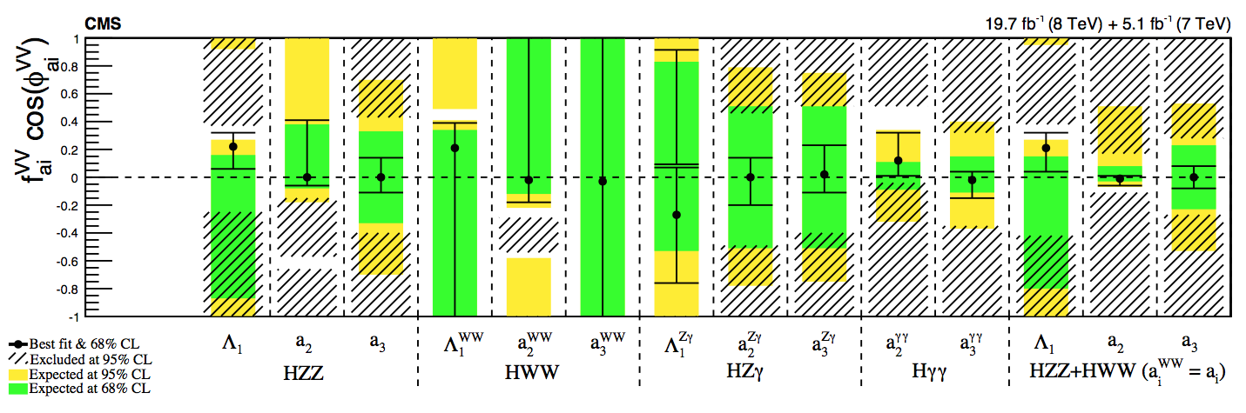
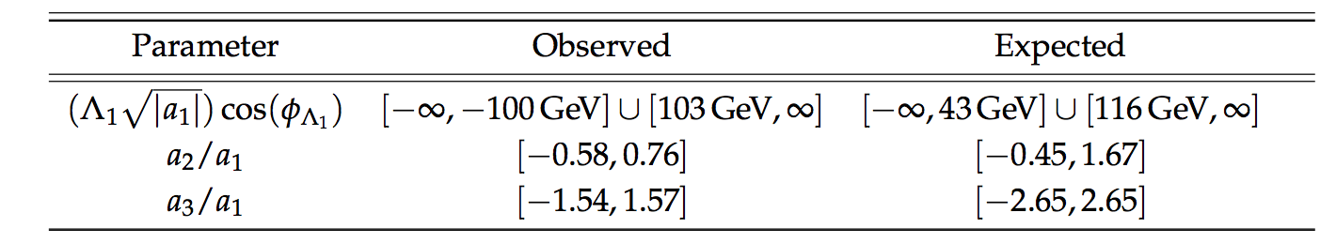
Summary of anomalous couplings
Allowed confidence level intervals for anomalous coupling parameters assuming real coupling ratios (π or 0)
Assuming custodial symmetry: pure 0_{h}⁺ (related to f_{a2}) excluded at 99.93% CL and pure 0⁻ (related to f_{a3}) excluded at 99.99% CL

Slide 18
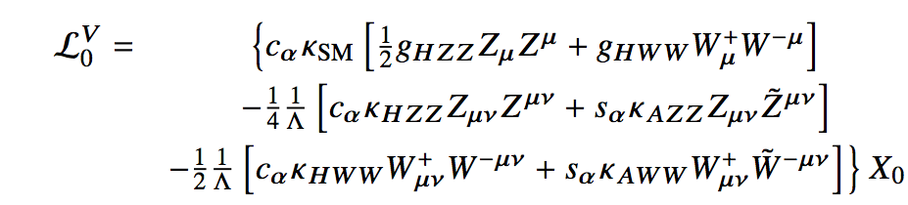
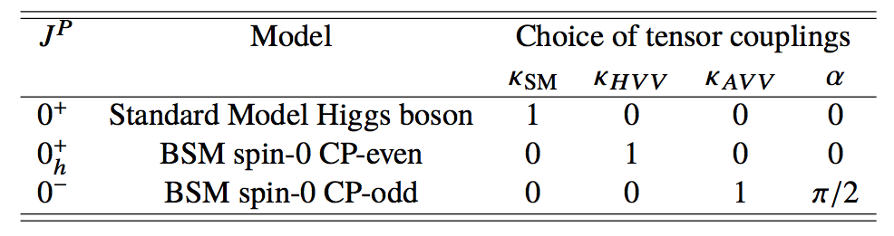
Spin-0: ATLAS
Equivalent approach → Spin-0 Lagrangian can be written with a slightly different parametrization as :
Here, the coupling constants κ_{SM}, κ _{HVV}, κ _{AVV} and the mixing angle α determine the J^{P} status of the Higgs:
The measurement is done by fitting coupling ratios to the discriminant observables for H → WW and H → ZZ processes and their combination, assuming one BSM coupling at the time
SM
BSM CP-even
BSM CP-odd

Slide 19
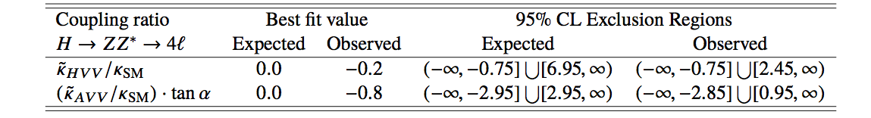
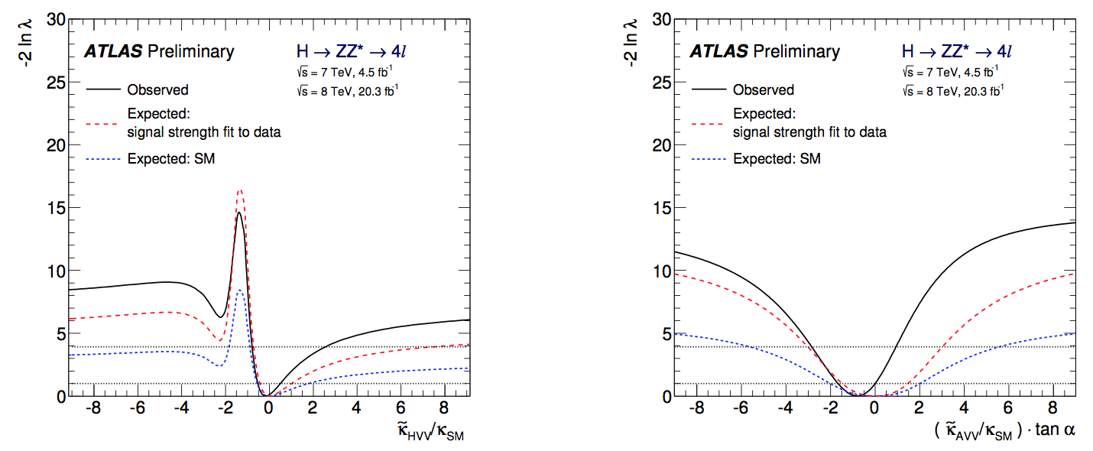
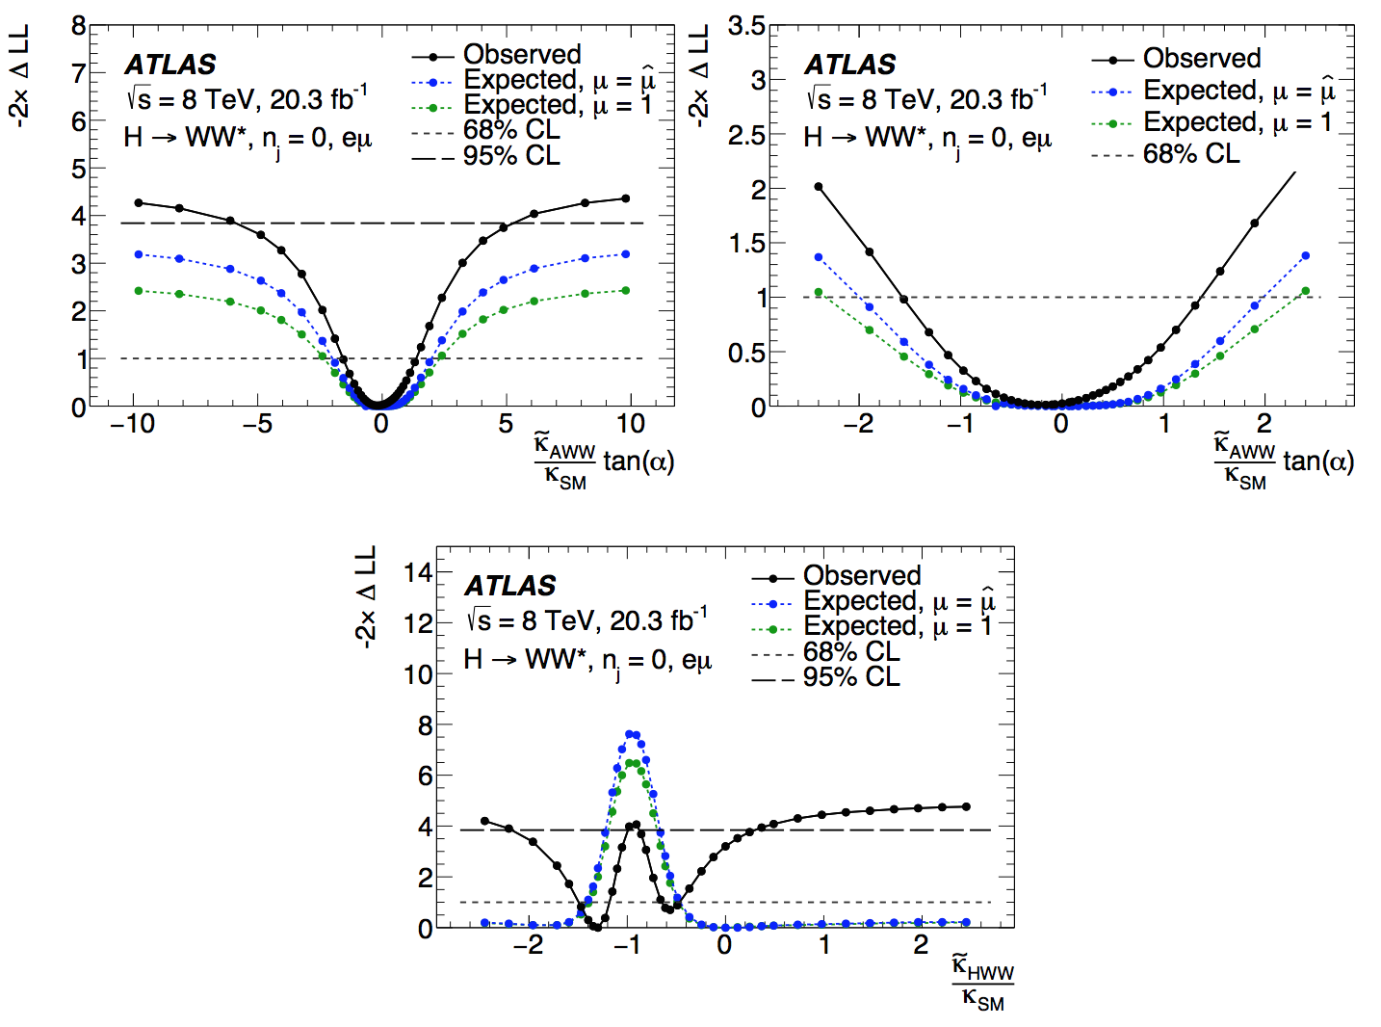
Coupling ratios
CP-Even
CP-Odd
CP-Even
CP-Odd
CP-Odd

Slide 20
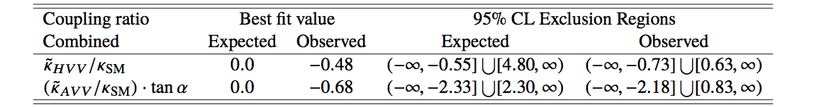
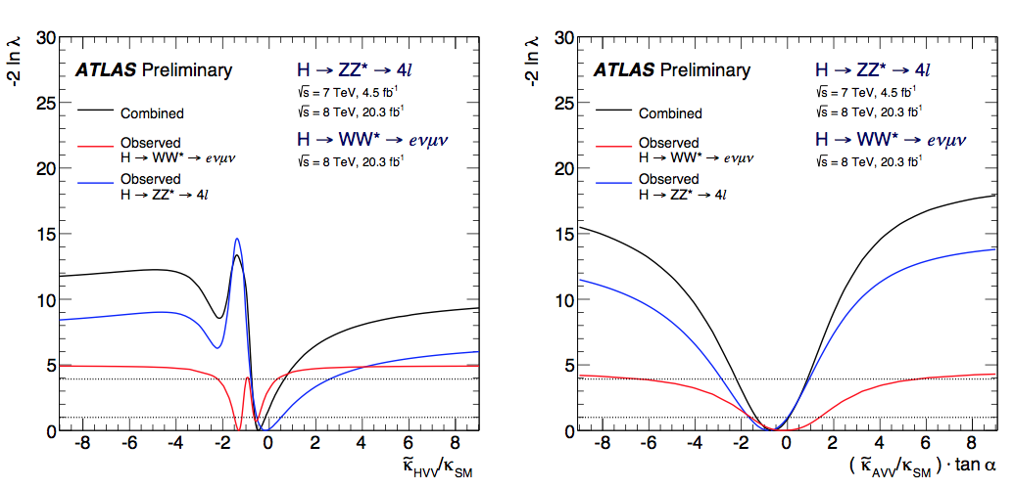
Coupling ratios: Combination
CP-Even
CP-Odd

Slide 21
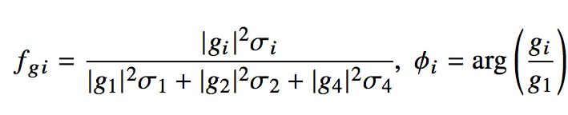
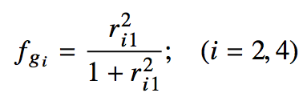
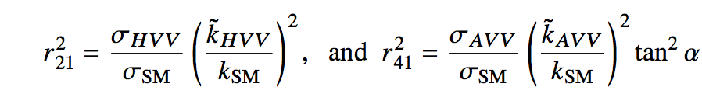
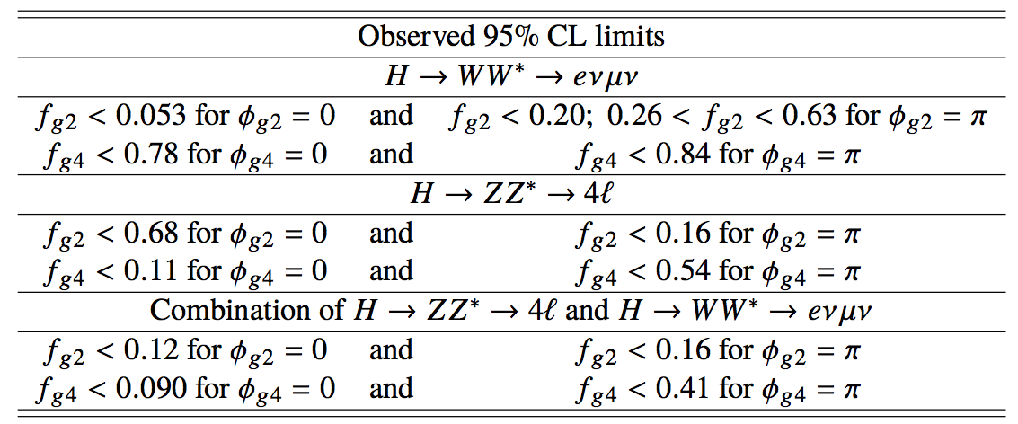
Effective cross sections
ATLAS also provides the results in terms of effective cross section fractions in the same way as CMS, using the equivalent f_{gi} parameters:
The coupling ratios relate to the effective cross section fractions as
f_{g2} = f_{a2}, f_{g4} = f_{a3}

Slide 22
Parameter | CMS | ATLAS
 | H→ZZ
f_{a2} = f_{g2} | [-0.66, -0.57] U [0.15, 1.00] | [-0.16, 0.68]
f_{a3} = f_{g4} | [-0.40, 0.43] | [-0.54, 0.11]
f_{Λ1} | [-0.25, 0.37]
 | H→WW
f_{a2}^{WW} = f_{g2}^{WW} | [-1.00, -0.54] U [-0.29, 1.00] | [-0.63, -0.26] U [-0.20, 0.053]
f_{a3}^{WW} = f_{g4}^{WW} | [-1.00, 1.00] | [-0.84, 0.78]
f_{Λ1}^{WW} | [-1.00, 1.00]
 | H→ZZ and H→WW Combination (a_{i}^{ZZ}=a_{i}^{WW})
f_{a2} = f_{g2} | [-0.11,0.17] | [-0.16, 0.12]
f_{a3} = f_{g4} | [-0.27, 0.28] | [-0.41, 0.090]
f_{Λ1} | [-0.42, 0.38]
 | H→Zγ*→4l
f_{a2}^{Zγ} = f_{g2}^{Zγ} | [-0.49, 0.46]
f_{a3}^{Zγ}= f_{g4}^{Zγ} | [-0.40, 0.51]
f_{Λ1}^{Zγ} | [-1.00, 1.00]
 | H→γ*γ*→4l
f_{a2}^{γγ} = f_{g2}^{γγ} | [-0.04, 0.51]
f_{a3}^{γγ} = f_{g4}^{γγ} | [ -0.35, 0.32]

Slide 23
Summary
Study of the spin, parity, and anomalous HVV couplings of the Higgs boson by ATLAS and CMS using the full LHC Run-1 dataset
H→ZZ, H→WW, and H→ γγ decays
Based on kinematic variables
Exotic scenarios with spin-1 and -2 have been ruled out at 99%CL or higher → The Higgs boson has spin 0
Pure pseudoscalar 0⁻ and pure 0⁺_{h} have also been ruled out
The Higgs still can be in a mixed CP state → anomalous contributions
Tensor structure of the HVV interactions studied under the spin-0 assumption
Via parameter measurement → coupling ratios and effective cross sections
No signs of deviations from the SM with the data available
The Higgs boson is compatible with the SM hypotheses J^{CP} = 0⁺⁺
If it is exactly the SM Higgs, only Run-2 data will tell!

